Slide 1

Efficient String Transformation via Cyclic Rotations: An Algorithmic Approach
This presentation explores the efficient transformation of strings using cyclic rotations, a fundamental problem in computer science. We will delve into the algorithm's design, implementation, complexity analysis, and real-world applications.
R.Babu Eshwar-192211778.
CSA0603-Design analysis of algorithms for vertex cover problem

Slide 2

Introduction
String transformation problems involve converting one string into another through a sequence of operations. Cyclic rotations are a powerful tool for string manipulation, where a portion of the string is removed and appended to the front.
1
Text Processing
2
Cryptography
3
Data Transformation
Cyclic rotations are crucial in text editing, document comparison, and search algorithms.
String rotations are used in encryption techniques, where characters are shifted to obfuscate the original data.
Cyclic rotations are employed in data compression algorithms, where strings are compressed into more compact representations.

Slide 3
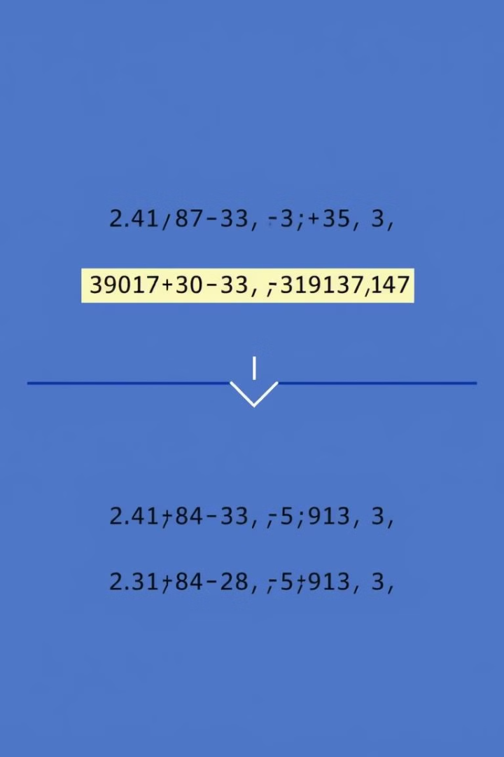
Problem Statement
Given two strings, 's' and 't', of equal length, the objective is to find the number of ways 's' can be transformed into 't' using a specific number of cyclic rotations. A cyclic rotation removes a suffix from the end and appends it to the beginning.
Input:
Strings 's' and 't', and an integer 'k' representing the number of rotations.
Output:
The number of ways 's' can be transformed into 't' using exactly 'k' rotations.

Slide 4
Key Challenges
This problem presents several challenges due to the nature of string rotations and the need for efficient solutions.
Large Input Sizes
Multiple Rotations
Modular Arithmetic
The strings can be very long, requiring efficient algorithms to handle the processing.
The number of possible rotations increases rapidly with the string length, requiring careful optimization.
The number of rotations can be very large, requiring modular arithmetic to avoid integer overflow.

Slide 5
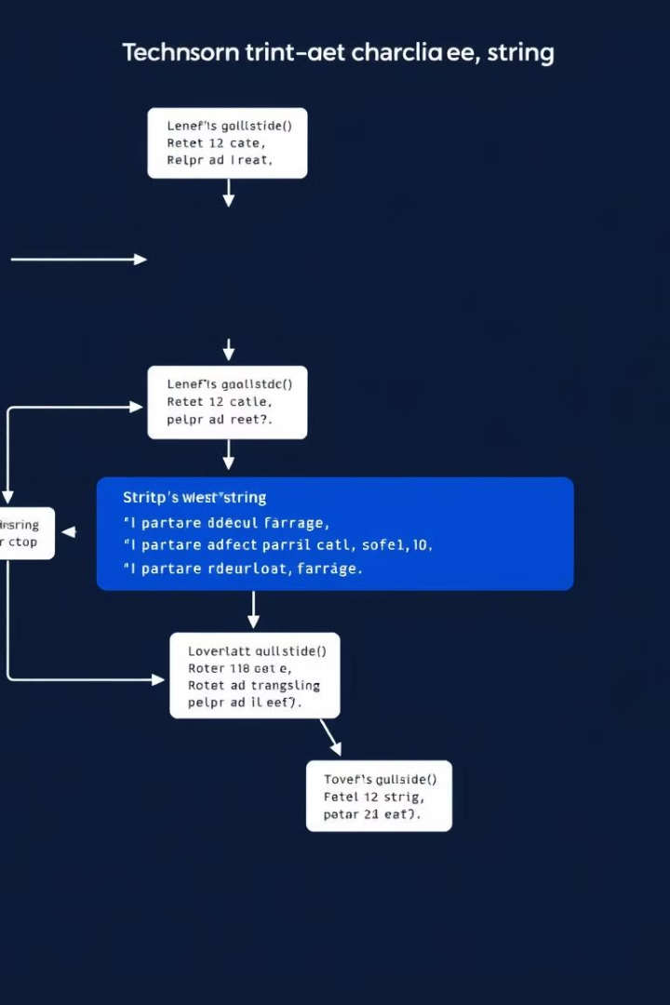
Approach and Algorithm
We propose a systematic approach involving iteration, comparison, and modular arithmetic to solve the problem efficiently.
1
Iteration
We iterate through all possible rotations of the string 's'.
2
Comparison
For each rotation, we check if it matches the target string 't'.
3
Modular Arithmetic
We use modular arithmetic to handle the large number of possible rotations.

Slide 6

Complexity Analysis
The time complexity of the algorithm is analyzed based on the number of rotations required to find a match.
Best Case
Worst Case
Average Case
O(n) – The match is found in the first rotation.
O(n²) – The match is found in the last rotation or no match exists.
O(n²) – On average, half the rotations need to be checked before finding a match.

Slide 7
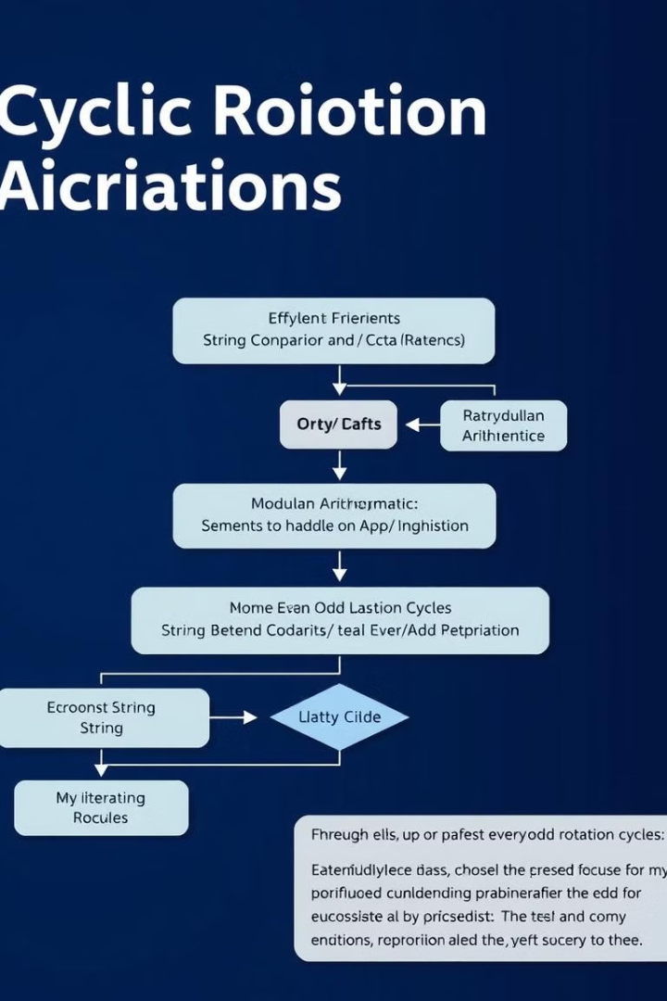



Algorithm Optimization Techniques
Optimizing the algorithm's performance is crucial to handling large input sizes and complex rotations.
Efficient String Comparison
We can optimize the string comparison process using efficient algorithms like the Knuth-Morris-Pratt (KMP) algorithm.
Modular Arithmetic
Modular arithmetic allows us to handle large values and prevent integer overflow, ensuring the algorithm's accuracy.
Even/Odd Rotation Cycles
Analyzing the rotation count as even or odd helps to simplify the logic and improve the algorithm's efficiency.

Slide 8
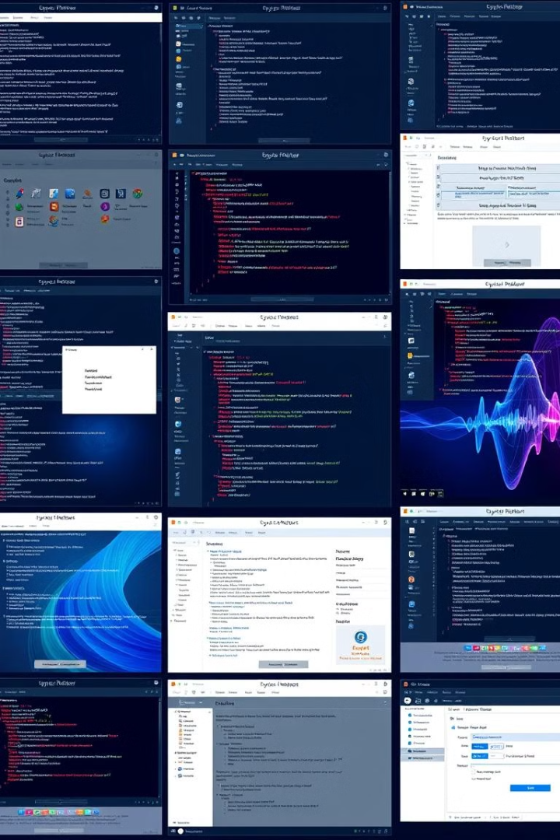



Real-World Applications
Cyclic rotations have widespread applications in various fields, from text processing to cryptography and data compression.
Text Processing
Cyclic rotations are used for efficient string manipulation in document comparison, plagiarism detection, and search engines.
Cryptography
String rotations play a crucial role in encryption techniques, where they are used to shift characters and obfuscate the original data.
Data Compression
Cyclic rotations are used in data compression algorithms to transform strings into more compact representations, reducing storage space.

Slide 9

Conclusion
This presentation has explored an algorithmic approach for efficiently transforming strings using cyclic rotations.
1
Efficient Solution
The algorithm effectively addresses the challenges of large input sizes, multiple rotations, and the need for modular arithmetic.
2
Practical Impact
This research provides a foundation for developing robust solutions for string manipulation problems in various applications.

Slide 10

Thank You
Thank you for your time and attention.

